Slide 1
Unit 2

Slide 2
Contents:
Unit-2 (6 Hours) | Inheritance and Interfaces
5 | Extended Class, Constructors in Extended classes, Inheriting and Redefining Members
6 | Type Compatibility and Conversion, protected, final Methods and Classes, Abstract methods and classes
7 | Object Class, Designing extended classes, Single Inheritance versus Multiple Inheritance
8 | Interface, Interface Declarations, Extending Interfaces
9 | Working with Interfaces, Marker Interfaces, When to Use Interfaces
10 | More Examples and Practices on Interfaces

Slide 3
Data Hiding
The data should not go out directly i.e outside person is not allowed to access the data, this is nothing but “Data Hiding”.
The main advantage of data hiding is we can achieve security. By using private modifier we can achieve data hiding.
Example:
public class Account{
private double balance;
public double balance()
{
return balance;
}
}

Slide 4
Abstraction
Hiding the internal implementation is nothing but abstraction.
The main advantages of abstraction are:
we can achieve security as we are not highlighting internal implementation.
Enhancement will become easy. Because with out effecting outside person we can change our internal implementation.
By using abstract classes and interface, we can achieve abstraction.

Slide 5
Encapsulation
If a class follows data hiding and abstraction such type of class is said to be ‘Encapsulated‘ class.
Encapsulation = Data Hiding + Abstraction.
Hiding the data behind the methods is the central concept of encapsulation i.e. We have to declare data members as private and we can provide access to that data by using getter and setter methods.
The main advantages of encapsulation are
We can achieve security.
Enhancement will become very easy.
It improves maintainability.
The main limitation of encapsulation is ,It increases length of the code and slow down the execution.
Notes:
Imagine you wrote the code for a class, and another dozen programmers from your company all wrote programs that used your class. Now imagine that later on, you didn't like the way the class behaved, because some of its instance variables were being set (by the other programmers from within their code) to values you hadn't anticipated. Their code brought out errors in your code. (Relax, this is just hypothetical.) Well, it is a Java program, so you should be able just to ship out a newer version of the class, which they could replace in their programs without changing any of their own code.
This scenario highlights two of the promises/benefits of Object Orientation (OO): flexibility and maintainability.

Slide 6
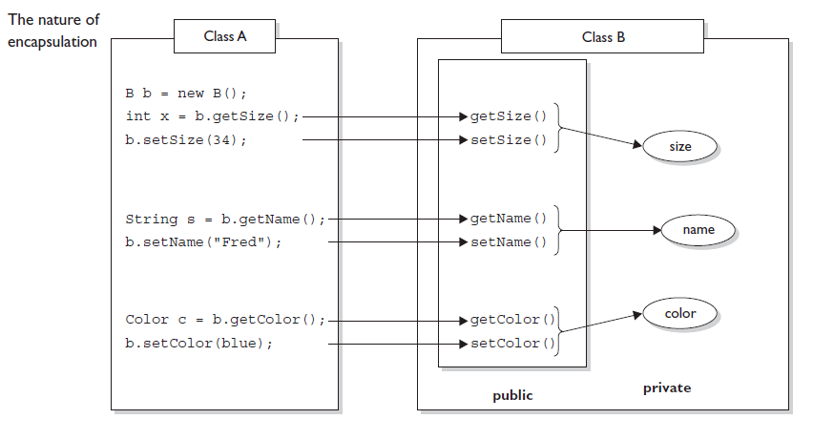

Slide 7
Encapsulation
What benefit can there be from having getters and setters that add no additional functionality? The point is, you can change your mind later, and add more code to your methods without breaking your API.

Slide 8
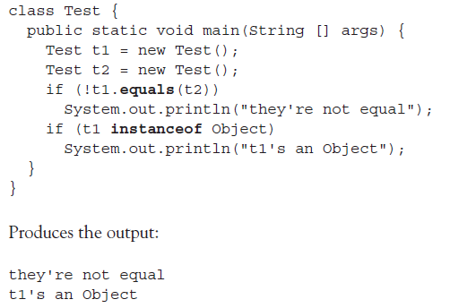
Inheritance: IS-A , Has-A
Every class in Java is a subclass of class Object, (except of course class Object itself). In other words, every class you'll ever use or ever write will inherit from class Object

Slide 9
Inheritance
Inheritance in java is a mechanism in which one object acquires all the properties and behaviors of parent object.
The idea behind inheritance in java is that we can create new classes that are built upon existing classes. When we inherit from an existing class, we can reuse methods and fields of parent class, and you can add new methods and fields also.
Inheritance represents the IS-A relationship, also known as parent-child relationship.

Slide 10
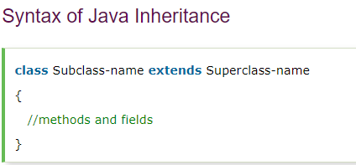
Inheritance
Two most common reasons to use inheritance are
■ To promote code reuse
■ To use polymorphism

Slide 11
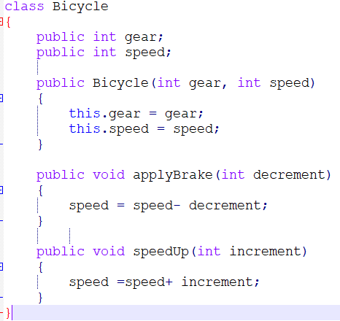
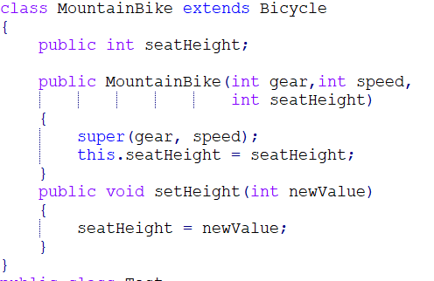

Slide 12
Types of Inheritance in Java (Online)
https://www.geeksforgeeks.org/inheritance-in-java/

Slide 13
What You Can Do in a Subclass?
A subclass inherits all of the public and protected members of its parent, no matter what package the subclass is in. If the subclass is in the same package as its parent, it also inherits the package-private members of the parent.
The inherited fields can be used directly, just like any other fields.
You can declare a field in the subclass with the same name as the one in the superclass, thus hiding it (not recommended).
You can declare new fields in the subclass that are not in the superclass.
The inherited methods can be used directly as they are.
You can write a new instance method in the subclass that has the same signature as the one in the superclass, thus overriding it.

Slide 14
What You Can Do in a Subclass?
You can write a new static method in the subclass that has the same signature as the one in the superclass, thus hiding it.
You can declare new methods in the subclass that are not in the superclass.
A subclass does not inherit the private members of its parent class. However, if the superclass has public or protected methods for accessing its private fields, these can also be used by the subclass.
Notes:
Here, myBike is of type MountainBike.
MountainBike is descended from Bicycle and Object. Therefore, a MountainBike is a Bicycle and is also an Object, and it can be used wherever Bicycle or Object objects are called for.
The reverse is not necessarily true: a Bicycle may be a MountainBike, but it isn't necessarily. Similarly, an Object may be a Bicycle or a MountainBike, but it isn't necessarily.

Slide 15
Notes:
Inheriting Constructors: A subclass inherits all the members (fields, methods, and nested classes) from its superclass. Constructors are not members, so they are not inherited by subclasses, but the constructor of the superclass can be invoked from the subclass.
Private member inheritance: A subclass does not inherit the private members of its parent class. However, if the superclass has public or protected methods(like getters and setters) for accessing its private fields, these can also be used by the subclass.
Default superclass: Except Object class, which has no superclass, every class has one and only one direct superclass (single inheritance). In the absence of any other explicit superclass, every class is implicitly a subclass of Object class.
Superclass can only be one: A superclass can have any number of subclasses. But a subclass can have only one superclass. This is because Java does not support multiple inheritance with classes. Although with interfaces, multiple inheritance is supported by java.

Slide 16
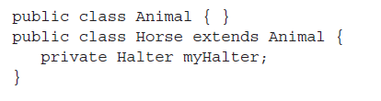
IS-A and HAS-A Relationships
In OO, the concept of IS-A is based on class inheritance or interface implementation. IS-A is a way of saying, "this thing is a type of that thing.”
For example, a Mustang is a type of horse, so in OO terms we can say, "Mustang IS-A Horse." Honda City IS-A Car. Broccoli IS-A Vegetable
HAS-A relationships are based on usage, rather than inheritance. In other words, class A HAS-A B if code in class A has a reference to an instance of class B.
Notes:
Horse class has an instance variable of type Halter, so you can say that "Horse HAS-A Halter." In other words, Horse has a reference to a Halter. Horse code can use that Halter reference to invoke methods on the Halter, and get Halter behavior without having Halter-related code (methods) in the Horse class itself.

Slide 17
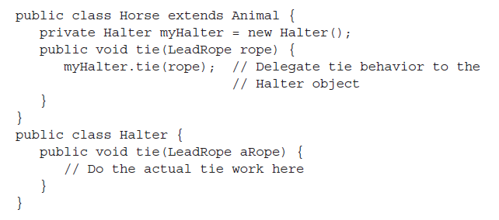
IS-A and HAS-A Relationships
HAS-A relationships allow you to design classes that follow good OO practices by not having monolithic classes that do a gazillion different things.
Classes (and their resulting objects) should be specialists. The more specialized the class, the more likely it is that you can reuse the class in other applications
Notes:
Users of the Horse class (that is, code that calls methods on a Horse instance),
think that the Horse class has Halter behavior. The Horse class might have a
tie(LeadRope rope) method, for example. Users of the Horse class should never
have to know that when they invoke the tie() method, the Horse object turns
around and delegates the call to its Halter class by invoking myHalter.tie(rope).
In OO, we don't want callers to worry about which class or which object
is actually doing the real work. To make that happen, the Horse class hides
implementation details from Horse users. Horse users ask the Horse object to
do things (in this case, tie itself up), and the Horse will either do it or, as in this
example, ask something else to do it. To the caller, though, it always appears that
the Horse object takes care of itself. Users of a Horse should not even need to know
that there is such a thing as a Halter class

Slide 18
IS-A and HAS-A Relationships
If we put all the Halter-related code directly into the Horse class, we'll end up duplicating code in the Cow class, UnpaidIntern class, and any other class that might need Halter behavior. By keeping the Halter code in a separate, specialized Halter class, we have the chance to reuse the Halter class in multiple applications.

Slide 19

IS-A relationship based on interface implementation
GameShape class that was extended by two other classes, PlayerPiece and TilePiece. Imagine we want to animate some of the shapes on the game board. But not all shapes can be animatable, so what do we do with class inheritance?
Could we create a class with an animate() method, and have only some of the GameShape subclasses inherit from that class?
Notes:
1. If we can, then we could have PlayerPiece, for example, extend both the GameShape class and Animatable class,
while the TilePiece would extend only GameShape. But no, this won't work! Java
supports only single inheritance! That means a class can have only one immediate
superclass. In other words, if PlayerPiece is a class, there is no way to say
something like this:

Slide 20

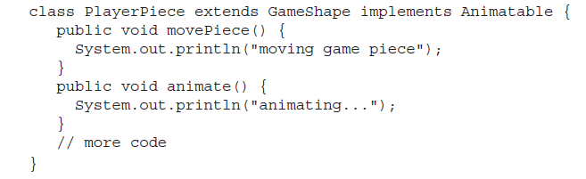
IS-A relationship
2. Could we simply put the animate() code in GameShape, and then disable the method in classes that can't be animated?
3. Solution: create an Animatable interface, and have only the GameShape subclasses that can be animated implement that interface. Here's the interface
Notes:
2. bad design choice for many reasons, including it's more errorprone, it makes the GameShape class less cohesive (more on cohesion in a minute),
and it means the GameShape API "advertises" that all shapes can be animated, when in fact that's not true since only some of the GameShape subclasses will be able to successfully run the animate() method
3. There are several advantages in utilizing the features of Interfaces in general programming. As you may already know, interfaces define a set of functionality as a rule or a contract. When you implement an interface all of these functionality must be implemented in the concrete class

Slide 21
IS-A relationship
So now we have a PlayerPiece that passes the IS-A test for both the GameShape class and the Animatable interface.
PlayerPiece player = new PlayerPiece();
Object o = player;
GameShape shape = player;
Animatable mover = player;

Slide 22
Polymorphism
Polymorphism is an important Object oriented concept and widely used in Java and other programming languages. Polymorphism in java is supported along with other concepts like Abstraction, Encapsulation, and Inheritance.
How Polymorphism supported in Java?
Java has excellent support of polymorphism in terms of Inheritance, method overloading and method overriding. Method overriding allows Java to invoke method based on a particular object at run-time instead of declared type while coding.
Notes:
Method overloading and method overriding uses concept of Polymorphism in Java where method name remains same in two classes but actual method called by JVM depends upon object at run time and done by dynamic binding in Java. Java supports both overloading and overriding of methods. In case of overloading method signature changes while in case of overriding method signature remains same and binding and invocation of method is decided on runtime based on actual object. This facility allows Java programmer to write very flexibly and maintainable code using interfaces without worrying about concrete implementation. One disadvantage of using Polymorphism in code is that while reading code you don't know the actual type which annoys while you are looking to find bugs or trying to debug program. But if you do Java debugging in IDE you will definitely be able to see the actual object and the method call and variable associated with it

Slide 23
Static vs Dynamic binding
If you have more than one method of same name (method overriding) or two variable of same name in same class hierarchy it gets tricky to find out which one is used during runtime as a result of there reference in code.
This problem is resolved using static and dynamic binding in Java. its process used to link which method or variable to be called as result of there reference in code. Most of the references is resolved during compile time but some references which depends upon Object and polymorphism in Java is resolved during runtime when actual object is available.

Slide 24
Static vs Dynamic binding
Static binding in Java occurs during Compile time while Dynamic binding occurs during Runtime.
private, final and static methods and variables uses static binding and bonded by compiler while virtual methods are bonded during runtime based upon runtime object.
Static binding uses Type(Class in Java) information for binding while Dynamic binding uses Object to resolve binding.
Overloaded methods are bonded using static binding while overridden methods are bonded using dynamic binding at runtime.

Slide 25
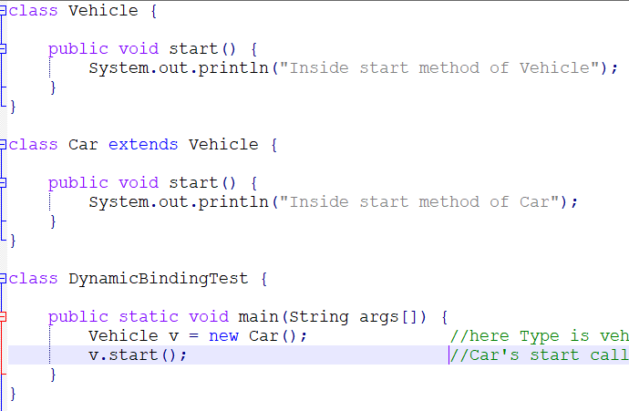
Notes:
In this example of Dynamic Binding we have used concept of method overriding. Car extends Vehicle and overrides its start() method and when we call start() method from a reference variable of type Vehicle, it doesn't call start() method from Vehicle class instead it calls start() method from Car subclass because object referenced by Vehicle type is a Car object. This resolution happens only at runtime because object only created during runtime and called dynamic binding in Java. Dynamic binding is slower than static binding because it occurs in runtime and spends some time to find out actual method to be called.

Slide 26
Overloading in Java
Overloading allows different methods to have same name, but different signatures where signature can differ by number of input parameters or type of input parameters or both. Overloading is related to compile time (or static) polymorphism.
Advantage of method overloading: If we have to perform only one operation, having same name of the methods increases the readability of the program.
Different ways to overload the method
1. By changing number of arguments
2. By changing the data type
3. By changing order of the data type
Note: In java, Method Overloading is not possible by changing the return type of the method only.

Slide 27
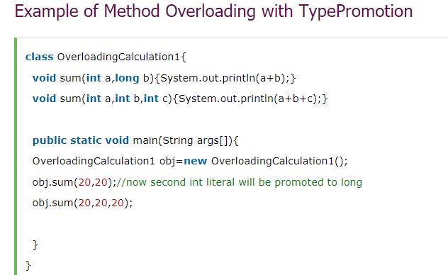
Can we overload java main() method?
Does Java support Operator Overloading?
Can we overload static methods?
Notes:
Unlike C++, Java doesn’t allow user defined overloaded operators. Internally Java overloads operators, for example + is overloaded for concatenation.

Slide 28
Method Overridding
Overriding is a feature that allows a subclass or child class to provide a specific implementation of a method that is already provided by one of its super-classes or parent classes.
When a method in a subclass has the same name, same parameters or signature and same return type(or sub-type) as a method in its super-class, then the method in the subclass is said to override the method in the super-class.
Method overriding is one of the way by which java achieve Run Time Polymorphism.The version of a method that is executed will be determined by the object that is used to invoke it

Slide 29
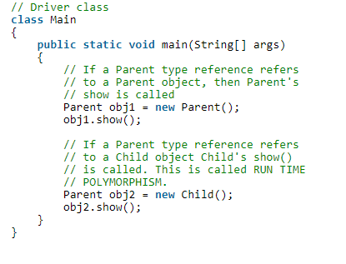
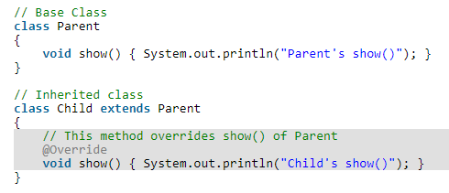

Slide 30
Rules for method overriding:
Overriding and Access-Modifiers : The access modifier for an overriding method can allow more, but not less, access than the overridden method. For example, a protected instance method in the super-class can be made public, but not private, in the subclass. Doing so, will generate compile-time error.
Final methods can not be overridden : If we don’t want a method to be overridden, we declare it as final
Static methods can not be overridden(Method Overriding vs Method Hiding) : When you defines a static method with same signature as a static method in base class, it is known as method hiding.
Private methods can not be overridden : Private methods cannot be overridden as they are bonded during compile time. Therefore we can’t even override private methods in a subclass.

Slide 31
Note
private methods are not just accessible from the outside of the class and final methods can not be overridden by the child class
private methods are well encapsulated in class and developer knows that they are not used anywhere else in code which gives them confident to change, modify or enhance private method without any side-effect.
By looking to the private method you know by sure that no one is using it which is great help during debugging java program.
private keyword in java allows most restrictive access to variables and methods and offer strongest form of Encapsulation. private members are not accessible outside the class and private method can not be overridden.
Should we make private method as final in Java?
Notes:
Using final and private in Java with method is a good choice but I don't think it offer any benefit in terms of performace or not. Rather this decision should be taken on the basis of design, functionality and ensuring readability of code. Since making a method final just limit there ability to be overridden, it doesn't make much sense to mark aprivate method as final in java, because private method can not overridden in Java by any means.

Slide 32
Conclusion
Connecting a method call to the method body is known as Binding. As Maulik said "Static binding uses Type(Class in Java) information for binding while Dynamic binding uses Object to resolve binding
1) Static binding in Java occurs during Compile time while Dynamic binding occurs during Runtime.
2) private, final and static methods and variables uses static binding and bonded by compiler while virtual methods are bonded during runtime based upon runtime object.
3) Static binding uses Type(Class in Java) information for binding while Dynamic binding uses Object to resolve binding.
3) Overloaded methods are bonded using static binding while overridden methods are bonded using dynamic binding at runtime.

Slide 33
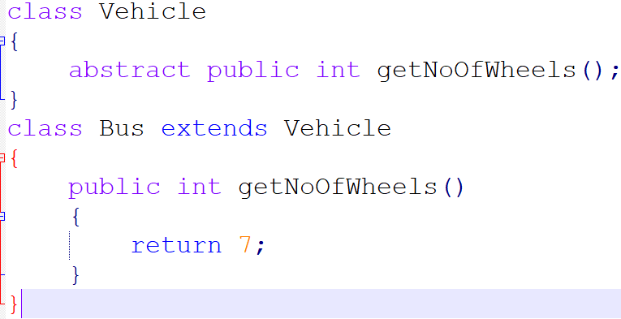
Abstract modifier in java
Applicable for classes and methods but not for variables
abstract methods:
If a class contains
atleast one abstract
method then compulsory
the class has to be declared
as abstract

Slide 34
B. Every child class should provide implementation for the abstract method present in the parent class.
abstract class:
Class with partial implementation.
Not allowed to create objects
Note:
1. If a class contains atleast one abstract method, then implementation is not complete and hence it is not recommended to create objects. To restrict object instantiation, we must declare class as abstract.
2 An abstract class can have zero abstract methods.

Slide 35
3.

Slide 36
protected Object clone() throws CloneNotSupportedException

